Slide 1


Multi-Tenancy
in the
Real World
By
Eitan Blumin

Slide 2
Copyright © 2023 Madeira Ltd
All Rights Reserved
Full rights, including copyrights, belong exclusively to Madeira Ltd
No use of the materials, in any form, is allowed,
unless receiving a prior written permission from Madeira Ltd

Slide 3


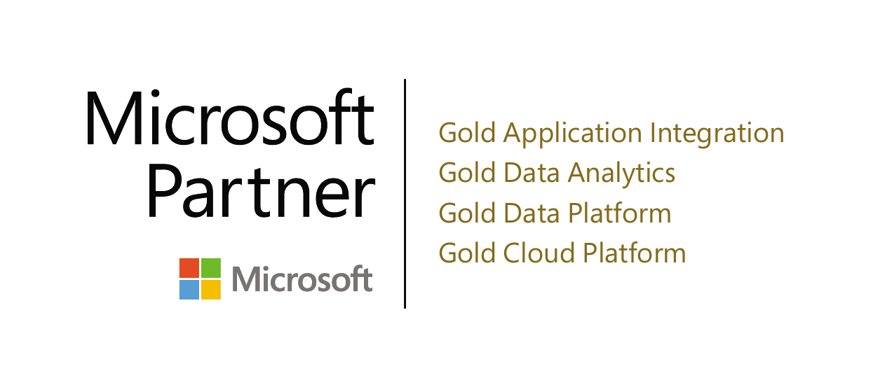
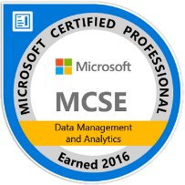
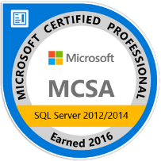
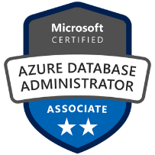
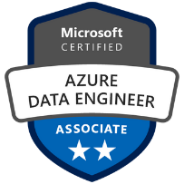
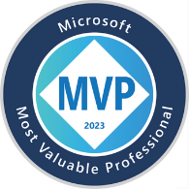
Eitan Blumin
Senior SQL Server Consultant
DBA Team Leader
Solutions Architect
Email: eitan@madeiradata.com
Twitter: @EitanBlumin
LinkedIn: linkedin.com/in/eitanblumin
Blog: EitanBlumin.com
Podcast: SqlServerRadio.co.il
SqlServerRadio.com
MadeiraData.com

Slide 4
Before we dive in
What you are about to see is based on a real-world project
The people and organizations involved have been censored
You will see a specific implementation that was a good fit for a specific scenario, but your own use case may vary

Slide 5
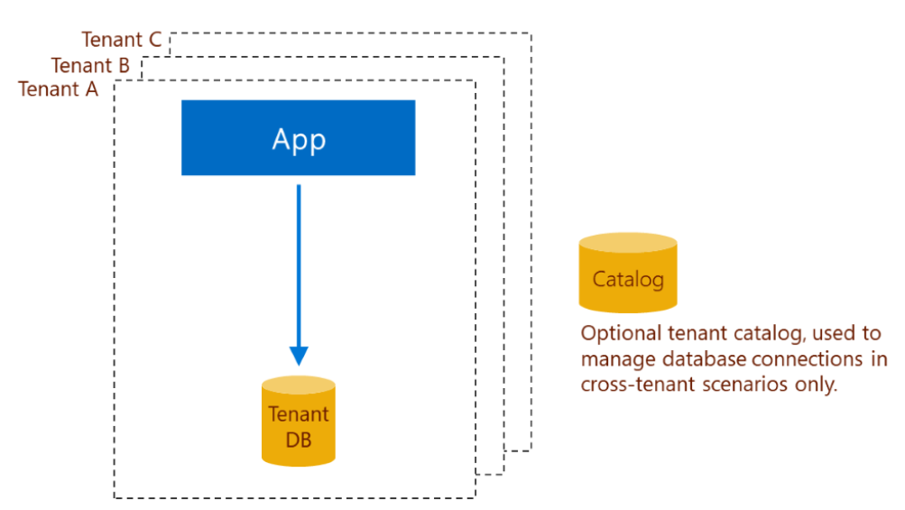

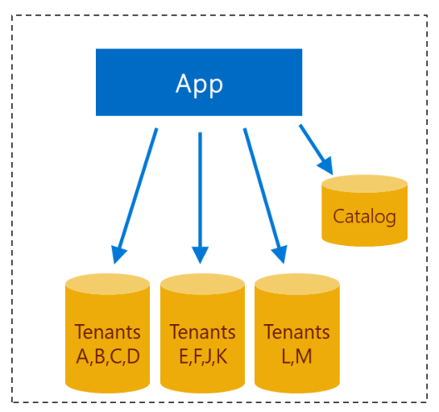
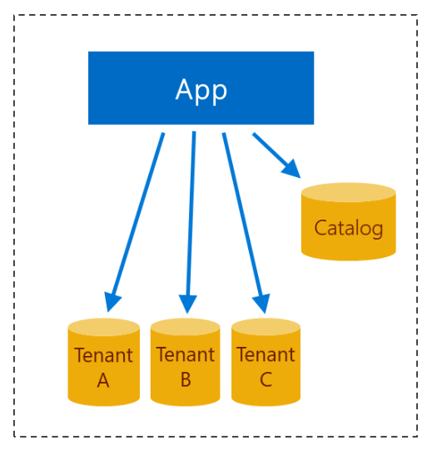
Multi-Tenancy Models
https://learn.microsoft.com/azure/azure-sql/database/saas-tenancy-app-design-patterns
Standalone app with single-tenant database
Multi-tenant app with sharded multi-tenant databases
Multi-tenant app with database-per-tenant
Notes:
https://learn.microsoft.com/azure/azure-sql/database/saas-tenancy-app-design-patterns

Slide 6
Tenancy models compared
https://learn.microsoft.com/azure/azure-sql/database/saas-tenancy-app-design-patterns
Measurement | Standalone app | Database-per-tenant | Sharded multi-tenant
Scale | Medium 1-100s | Very high 1-100,000s | Unlimited 1-1,000,000s
Tenant isolation | Very high | High | Low; except for any single tenant (that is alone in an MT db).
Database cost per tenant | High; is sized for peaks. | Low; pools used. | Lowest, for small tenants in MT DBs.
Performance monitoring and management | Per-tenant only | Aggregate + per-tenant | Aggregate; although is per-tenant only for singles.
Development complexity | Low | Low | Medium; due to sharding.
Operational complexity | Low-High. Individually simple, complex at scale. | Low-Medium. Patterns address complexity at scale. | Low-High. Individual tenant management is complex.
Notes:
https://learn.microsoft.com/azure/azure-sql/database/saas-tenancy-app-design-patterns

Slide 7




Meet Company Y
App Service
Web App
Single database
Single web app
Single backend service
Several scheduled SQL jobs
Requires “on-prem” installation
App and database are also stored in source control
On-Prem
MSSQL Database
Scheduled Jobs

Slide 8
Company Y Requirements
Legacy On-Prem ➡ SaaS on Cloud
Single Tenant ➡ Multi-Tenant
Need to support large number of tenants
Fast Self-Service
end-users create tenants on their own
Automated Lifecycle
trial expiration
grace period
SQL Jobs ➡ Multi-Tenants?
Scalable Cross-Tenant Queries (BI & insights)
Minimal Time-To-Delivery
Azure SQL MI
Amazon RDS
(both limited to 100)
DACPAC
BACKUPS
Scalable automation
Per-tenant or cross-tenant
Azure SQL Database
Elastic Pools

Slide 9

So, which Multi-Tenancy model was selected?
Notes:
Pause for effect

Slide 10

Selected Solution:
Azure SQL on VM
Catalog
Cross-Tenant
Scheduled Jobs
Tenant Model
Tenant A
Tenant B
Tenant C
Tenant D
Notes:
Advantages:
* It can provide for each of the requirements made by Company Y, with the fast time-to-delivery being the most critical one.
Disadvantages:
* Cost is for the entire VM instead of per-tenant
* If we want to scale the VM further – this would mean downtime while the VM is being resized. We can solve this by setting up another VM with AlwaysOn. But then that’s another VM to pay for.

Slide 11

Base model: Standalone single-tenant app with single-tenant database
The codebase is shared between single-tenant and multi-tenant variants
Notes:
Application level isolation
In this model, the whole application is installed repeatedly, once for each tenant. Each instance of the app is a standalone instance, so it never interacts with any other standalone instance. Each instance of the app has only one tenant, and therefore needs only one database. The tenant has the database all to itself.
Each app instance is installed in a separate Azure resource group. The resource group can belong to a subscription that is owned by either the software vendor or the tenant. In either case, the vendor can manage the software for the tenant. Each application instance is configured to connect to its corresponding database.
Each tenant database is deployed as a single database. This model provides the greatest database isolation. But the isolation requires that sufficient resources be allocated to each database to handle its peak loads. Here it matters that elastic pools cannot be used for databases deployed in different resource groups or to different subscriptions. This limitation makes this standalone single-tenant app model the most expensive solution from an overall database cost perspective.
Vendor management
The vendor can access all the databases in all the standalone app instances, even if the app instances are installed in different tenant subscriptions. The access is achieved via SQL connections. This cross-instance access can enable the vendor to centralize schema management and cross-database query for reporting or analytics purposes. If this kind of centralized management is desired, a catalog must be deployed that maps tenant identifiers to database URIs.
https://learn.microsoft.com/en-us/azure/azure-sql/database/saas-tenancy-app-design-patterns?view=azuresql#c-standalone-single-tenant-app-with-single-tenant-database

Slide 12
Optimized model: Multi-tenant app with database-per-tenant
The system needs to be scalable and balanced.
The number of app instances needs to be independent of the number of tenants.
Tenants need to be equally distributed between app instances as much as possible.
Service
App
Notes:
This next pattern uses a multi-tenant application with many databases, all being single-tenant databases. A new database is provisioned for each new tenant. The app is scaled out horizontally by adding more app instances. The scaling could be based on workload and is independent of the number or scale of the individual databases.

Slide 13

Trick #1: App/Tenant Auto-Balance
Service1
Tenant A
Tenant B
Service2
Tenant D
Tenant E
Tenant C
Basic balancing algorithm:
Get and enumerate active services
If no active services – delete all mappings
Delete service-tenant mappings for inactive tenants/services
Per tenant, use modulu (%) NumOfActiveServices to match with a service and insert new mappings or update existing
TenantID | ServiceID
1 | 1
2 | 2
3 | 3
4 | 1
5 | 2
6 | 3

Slide 14
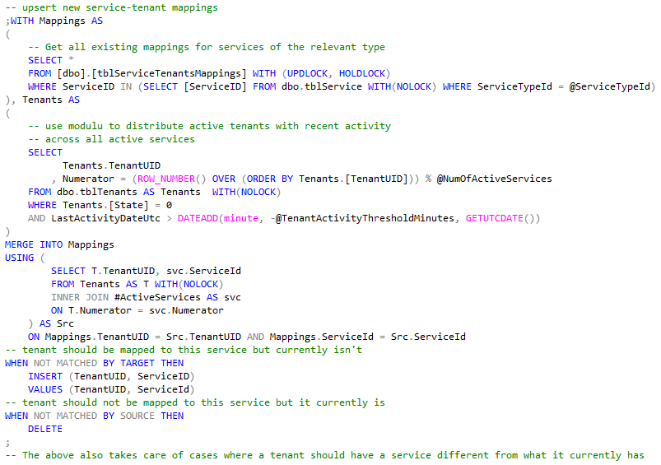

Slide 15

Trick #2: Fast Time-to-Delivery App Flow
If Multi-Tenant mode is enabled
Get list of mapped tenants for this ServiceID
Initialize a thread for each tenant (if not initialized already)
Connect to Catalog
If first time: Register self as a service and force rebalance
Sleep for X time
Update “service heartbeat”
Get a ServiceID
else
Tenant-specific Process
(legacy code)
Threads for de-mapped tenants need to be stopped/killed
Notes:
By keeping the core app engine single-tenant-specific, we can keep most of our legacy code unchanged.

Slide 16



Trick #3: Fast Self-Service Tenant Creation
DBCC CLONEDATABASE(@TenantModel,@DBName);
SET @CMD = N'ALTER DATABASE ‘
+ QUOTENAME(@DBName)
+ N' SET READ_WRITE WITH NO_WAIT;’
EXEC (@CMD);
EXEC dbo.[PROC_PopulateTenantDataTables]
@DBName
App
Tenant Model
Tenant D
REGISTER
~5 seconds to create a new tenant!
Notes:
The “Tenant Model” will work how the “model” database in SQL Server works.
It will be cloned using DBCC CLONEDATABASE which is a very fast operation (don’t forget to change to READ_WRITE mode).
And then a stored procedure will be executed to copy static/lookup tables from it.
This would not be supported in AWS RDS and Azure SQL Managed Instance.
Alternative for RDS: backup/restore using SQL native backups.
Alternative for Azure SQL Managed Instance: Only via Powershell/Az CLI/API

Slide 17


Trick #4: Multi-Tenant Change Automation
DbaTools (https://dbatools.io)
Publish-DbaDacPackage
Publish the Catalog
Publish the Tenant Model
Publish Foreach [active] Tenant
Optionally “lock” the version of specific tenant(s)
UPDATE tblTenants SET VersionLocked = 1 WHERE …
Powershell
2
1
Tenant Model
3
https://eitanblumin.com/project-type/ci-and-cd-with-ssdt
Notes:
Also possible to integrate with Azure DevOps CI/CD.
Deployment-aware database development is important here to allow for zero-downtime database deployments.
To learn more about CI/CD and DB DevOps: https://eitanblumin.com/project-type/ci-and-cd-with-ssdt/

Slide 18
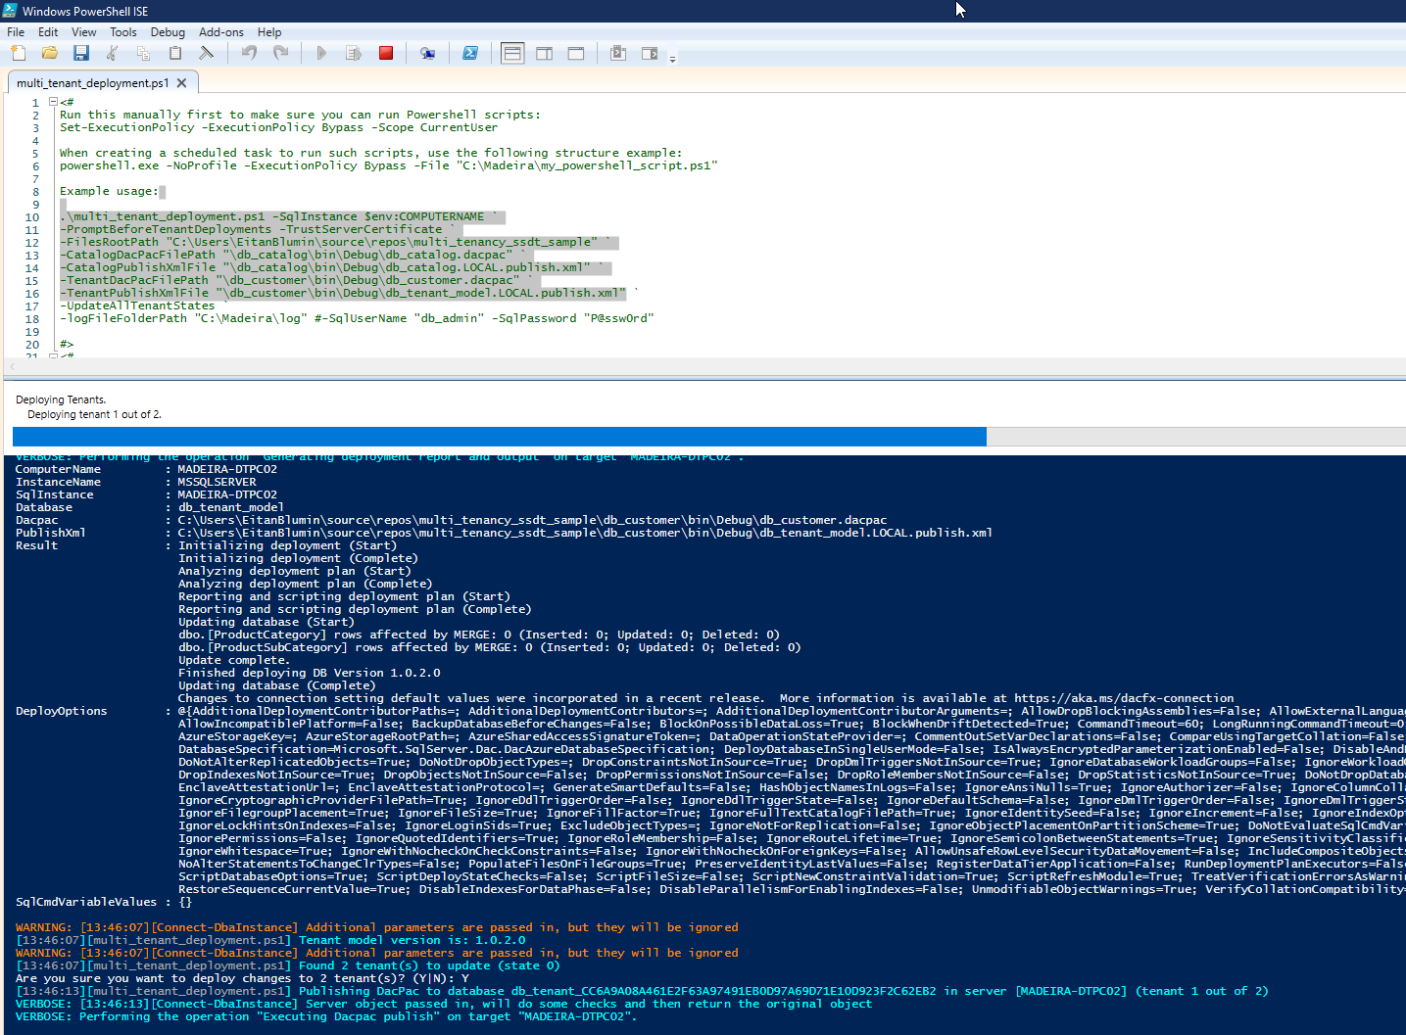

Notes:
Company Y specifically wanted version deployments to be manual, but the same idea could be implemented as part of an automated pipe

Slide 19

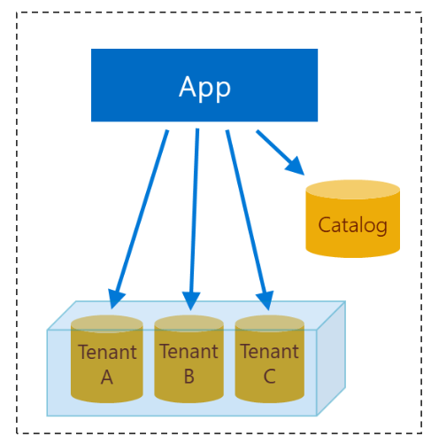
Trick #5: Multi-Tenant Job Execution
Single scheduled SQL job - executes a single stored procedure in the catalog.
Foreach tenant – execute equivalent stored procedure with same parameters.
Data-driven.
The SQL Job doesn’t need to be configured per-tenant.
Other automation methods?
Azure Automation
Azure Data Factory
Azure Functions
Others
SQL Job
1
2
Notes:
With large scales this could be problematic as this is a serial-execution pattern.
Possible alternatives could be taken into consideration to implement parallel execution instead.
But they still must be data-driven.

Slide 20
CREATE PROCEDURE [dbo].[PROC_ForEachTenantParameterized]
@CMD NVARCHAR(MAX)-- the SQL command to be used for outer sp_executesql.
, @XmlParams XML = NULL-- the XML definition of the parameter values
, @ServiceID int = NULL
, @TenantState tinyint = 0
AS
BEGIN
SET XACT_ABORT, ARITHABORT, NOCOUNT ON;
SET TRANSACTION ISOLATION LEVEL READ UNCOMMITTED;
DECLARE @CurrentTenant sysname, @spExecuteSql nvarchar(4000)
DECLARE Tenants CURSOR
LOCAL FAST_FORWARD
FOR
SELECT DISTINCT DBName
FROM [dbo].[FUNC_GetTenantsForService](@ServiceID, @TenantState)
OPEN Tenants
WHILE 1=1
BEGIN
FETCH NEXT FROM Tenants INTO @CurrentTenant;
IF @@FETCH_STATUS <> 0 BREAK; -- stop loop if reached EOF
SET @spExecuteSql = QUOTENAME(@CurrentTenant) + N'..sp_executesql'
EXEC @spExecuteSql @CMD, N'@XmlParams xml', @XmlParams
END
CLOSE Tenants
DEALLOCATE Tenants
END
Looks familiar?
https://eitanblumin.com/portfolio/advanced-dynamic-search-queries/

Slide 21

The Final Result
App/tenant load-balancing
App Service
App Service
Fast tenant registration
App Service
Catalog
Web App
Data-driven automation
Tenant Model
Time-to-delivery:
~half a year
Tenant A
Tenant B
Tenant C
New Tenant
Data-driven change automation
SSDT + Git

Slide 22

Final Thoughts
Focus on data-driven logic
Operational
Maintenance
Management
Automation
Don’t forget security
Design may vary for your use case
Need begets technology, but sometimes not?

Slide 23

Sample Project
GitHub.com/MadeiraData/multi_tenancy_ssdt_sample

Slide 24

Additional Resources
https://learn.microsoft.com/azure/azure-sql/database/saas-tenancy-app-design-patterns (duh, obviously)
Blog post series by Erwin Staal from 2020-2021: (focused on AzureSQL and EF, but incomplete as of today)
https://erwinstaal.nl/posts/database-per-tenant-series/
https://erwinstaal.nl/posts/db-per-tenant-catalog-database-infrastructure/
https://erwinstaal.nl/posts/db-per-tenant-catalog-database-ef-core-migrations/
https://erwinstaal.nl/posts/db-per-tenant-code/
https://eitanblumin.com/project-type/ci-and-cd-with-ssdt
https://github.com/MadeiraData/DynamicFilters/

Slide 25




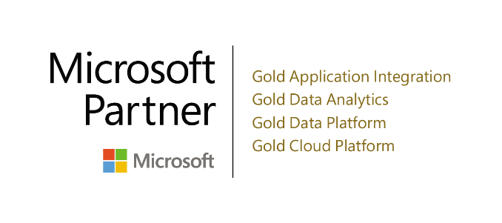
Time for Q&A
Name: Eitan Blumin
Email Address: eitan@madeiradata.com
Twitter: @EitanBlumin
LinkedIn: linkedin.com/in/eitanblumin
Blog: EitanBlumin.com
Podcast: SqlServerRadio.co.il |SqlServerRadio.com
GitHub: GitHub.com/MadeiraData |GitHub.com/EitanBlumin
GitHub.com/MadeiraData/multi_tenancy_ssdt_sample
MadeiraData.com

